Slide 1


Power Bi- capstone project Olympic data analysis
Notes:
Hi all, my name is Vineesha here i’m to give the overview on the Powerbi capstone project.

Slide 2

Objective of project:
To analyse the data of the Olympics
that have been held from the year 1896.
Notes:
The object of project is to

Slide 3


ER-Diagram:
Notes:
Here is the Er diagram I have created to analyze the data . First of all ive merge the tables and then created the fact table that had connection for overall data.

Slide 4
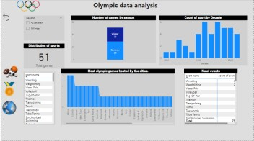

Presentation of dashboard:
Notes:
This the dashboard consists of four types of analysis. With the help of navigation ive connect the four pages.

Slide 5
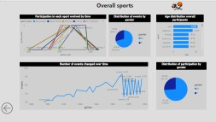

Notes:
This page tells about the sports .

Slide 6
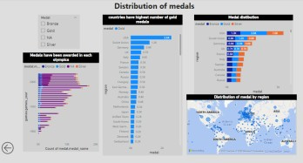

Notes:
Like the way this page tells about the distribution of medals.

Slide 7
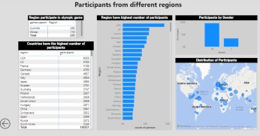

Notes:
And this is for participants from different regions.

Slide 8

About Olympics:
The first Olympic game were held every four years in the honour of god Zeus. The five coloured rings represent the five continents of the world. Those are Africa, The Americas, Asia, Europe and Oceania.
The Olympic include the summer and winter games. Each held in a different country once in a every four years.
The first summer Olympic games were held in country Athens, Greece, in 1896.
The first winter Olympic games were held in country Chamonix, France, in 1924.
Notes:
Lets get little bit overview of olympics

Slide 9

Findings of Olympic data:
Olympics games held in two different seasons. Totally 51 Olympics games held since 1896, on that 29 games were on Summer season and 22 games were on the winter season.
Athina And London have hosted the most number of Olympics over the summer season.
Distribution of sports :
Summer season-51, Winter season-15.
The sports Athletics, Shooting (83 events) have the highest number of events in Olympics.
Notes:
This indicates the observation from the Olympics data.

Slide 10

Distribution of events by gender:
Male participated totally in 187,037 events and female participated in 73,934 events.
The United states(5,783) and united kingdom(5,173) are the top two countries have the highest number of participants.
The united states and soviet union have won the most number of gold medals in Olympic history.
The sport Athletes have seen the most equal distribution of medal(Gold, Silver, Bronze) followed by the sport Swimming.
Notes:
Thank you.

